Slide 1

Cell-ebrating Efficiency: Optimization Algorithms Meet Biological Systems
Malachy McEvoy
Supervision by Dr. Andrea Weisse & Christoph Wagner
Notes:
Biomedical computation group

Slide 2

The pursuit of cell-free protein synthesis (CFPS)
Biochemical reactions independent of living cells
in vitro transcription and translation
No need for cell viability
Modular part insulation
Notes:
Goal of biotechnology – synthetic cell
Biochemical reactions that occur independently of living cells
Understanding transcription and translation – in vitro
CFPS allows modular construction of cellular components
Wide variety of biological products – therapeutic proteins, biosensors
No cell viability required

Slide 3
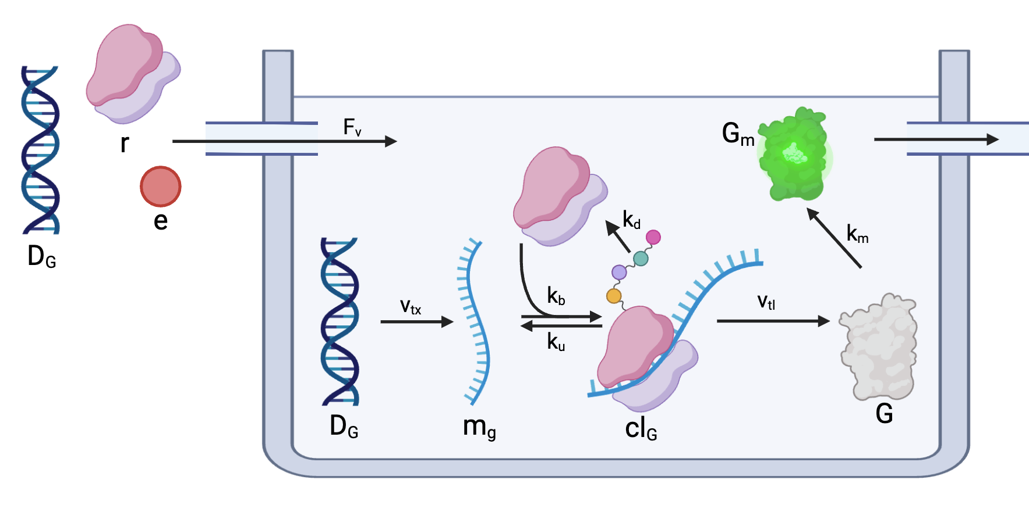

A simple cell-free system
Notes:
Energy, DNA and ribosomes are input into the system
DNA -> RNA -> GFP -> mature fluorescent protein
The system is diluted with fresh energy, DNA and ribosomes at discrete intervals
An equal volume is removed at each dilution interval

Slide 4
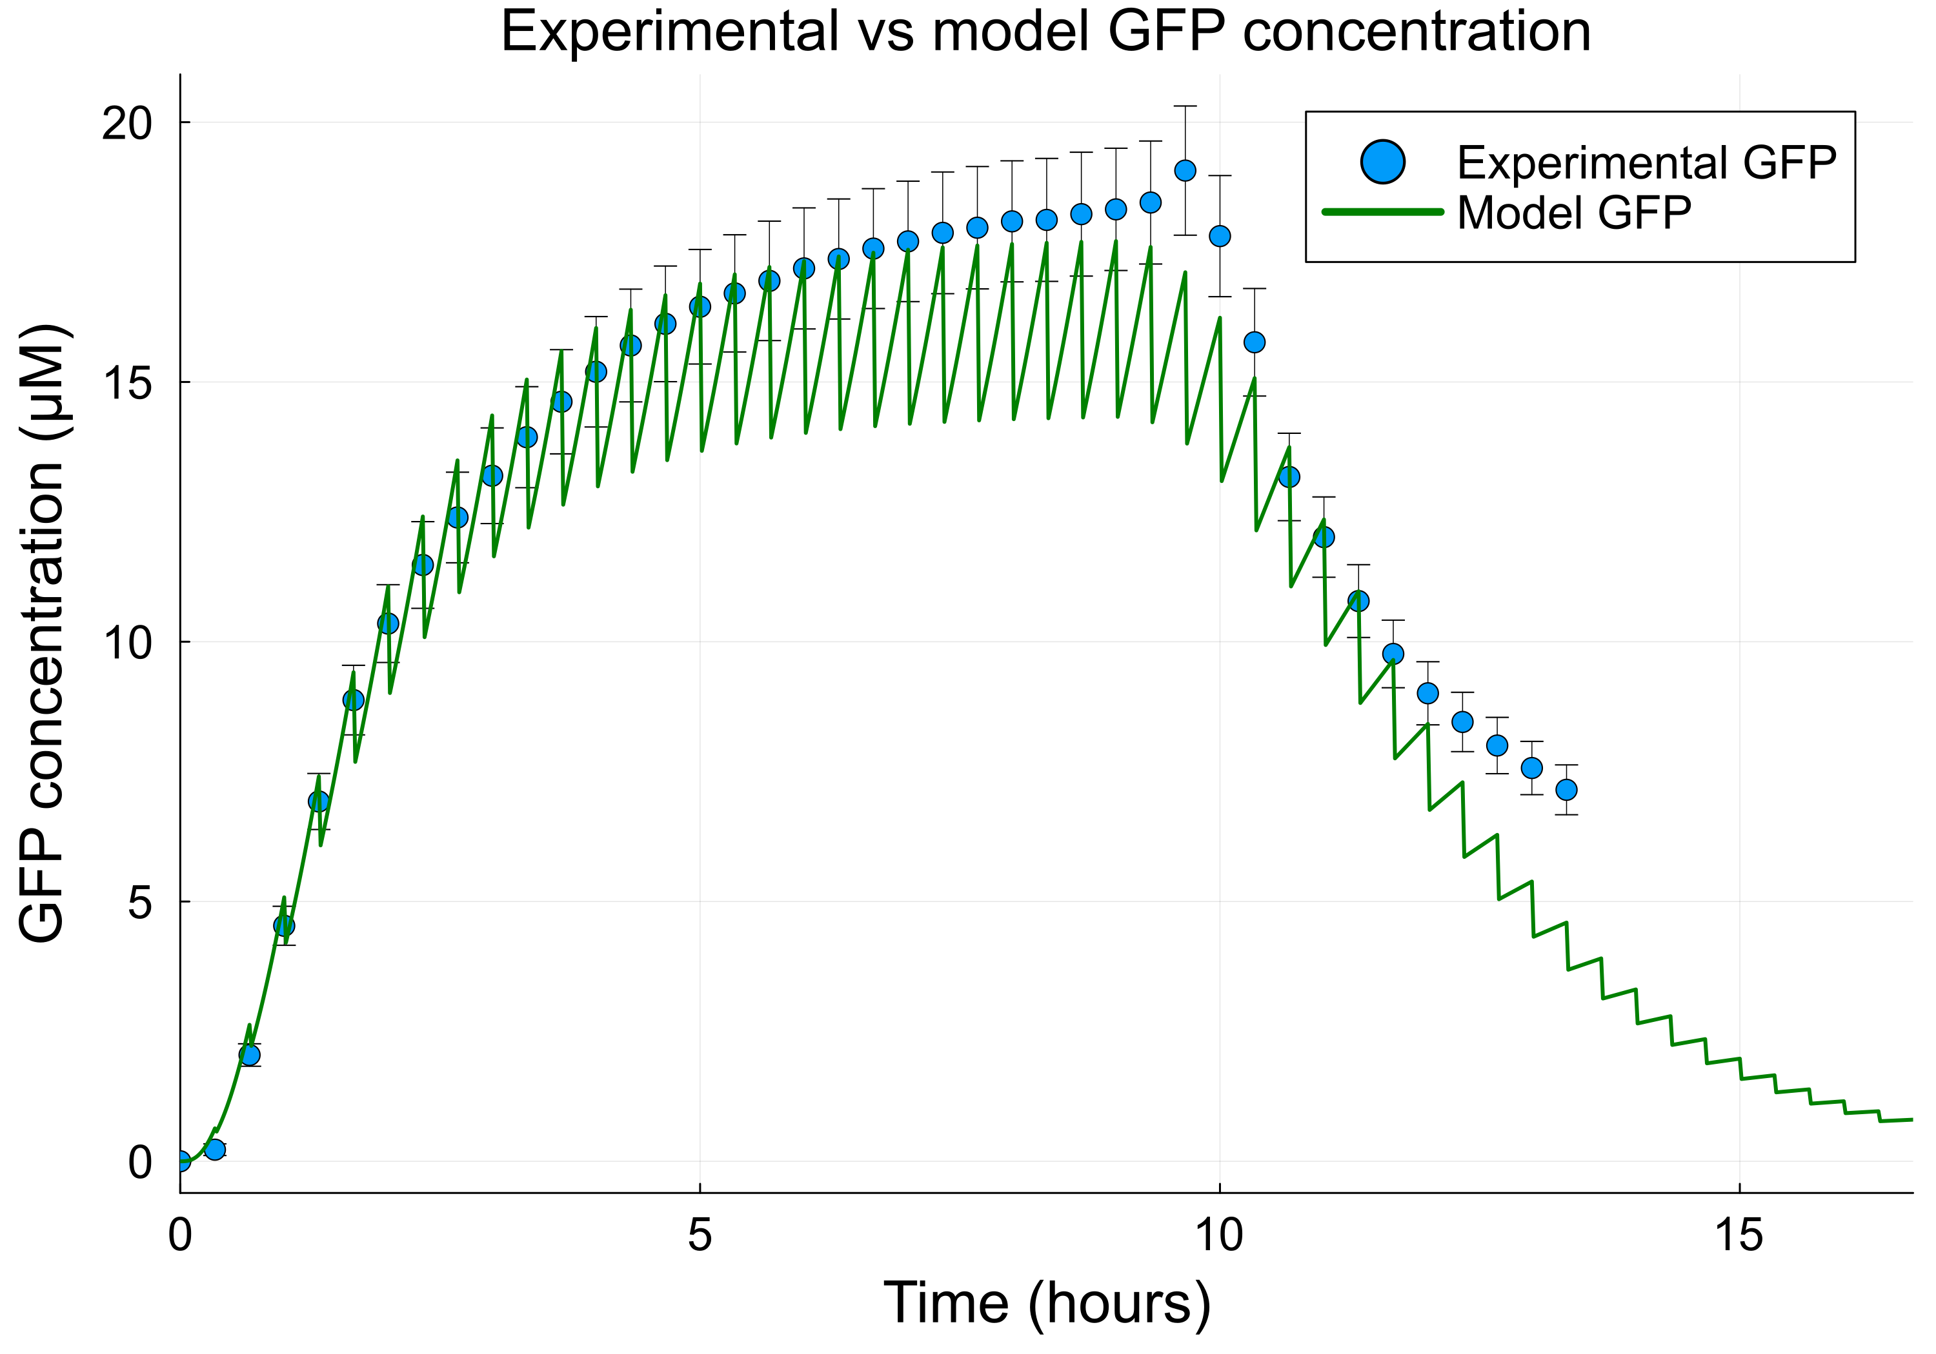
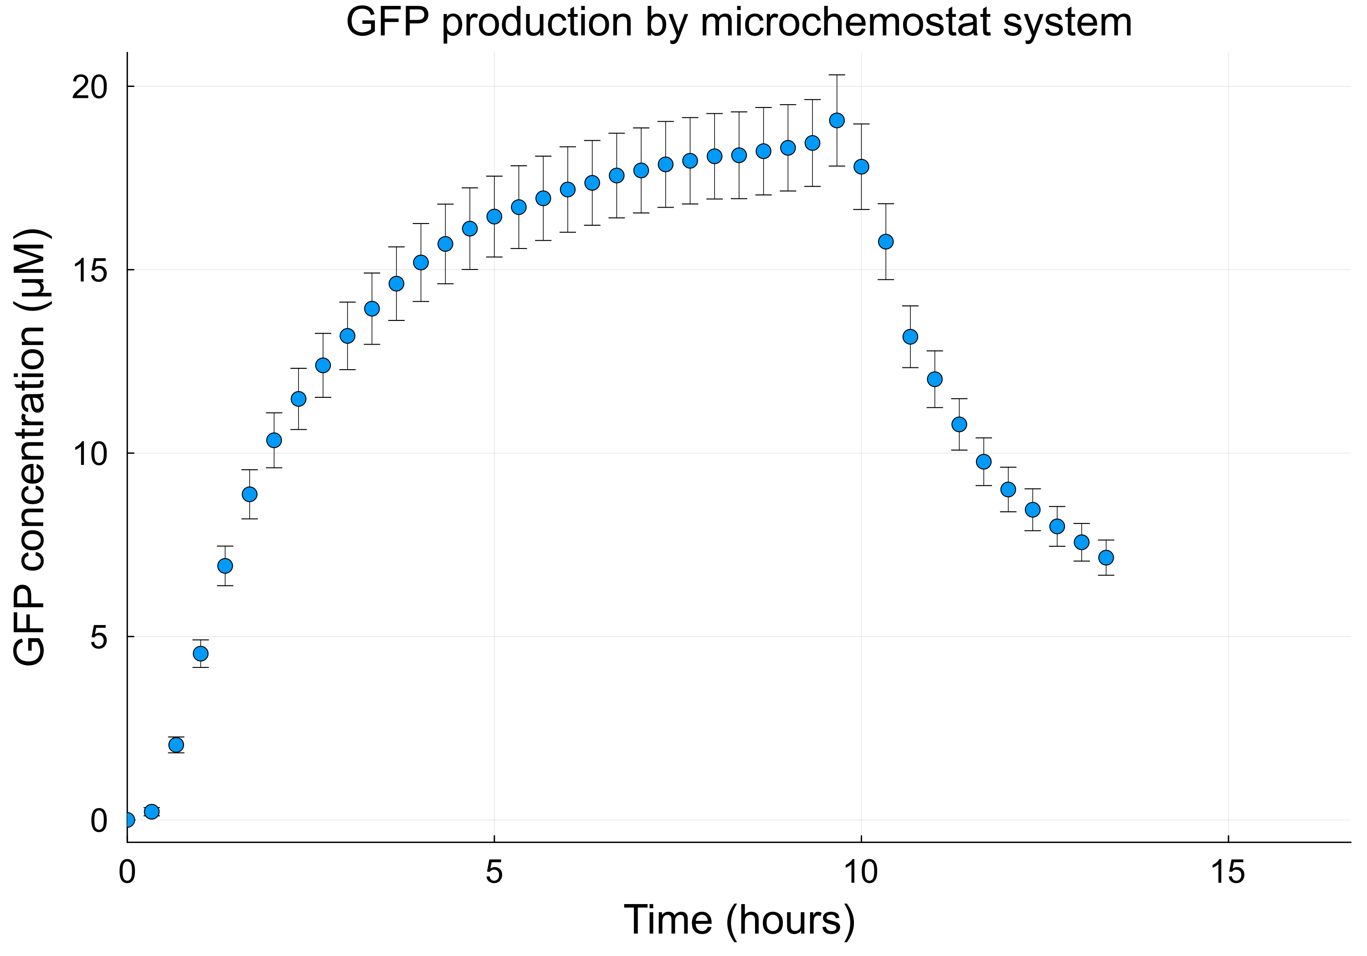


GFP production by chemostat
$$\frac{dG_{m}}{dt}=v_{tl}−μ∙G−μ⋅G_{m}$$
Notes:
GFP production from a chemostat experiment
Washout phase at 9 hours – DNA is no longer added to each dilution
Use of ODEs – describe concentration change over time
Construct a simulation of the system

Slide 5

Optimization: where engineering meets biology
Notes:
Engineers optimize building materials for a bridge

Slide 6
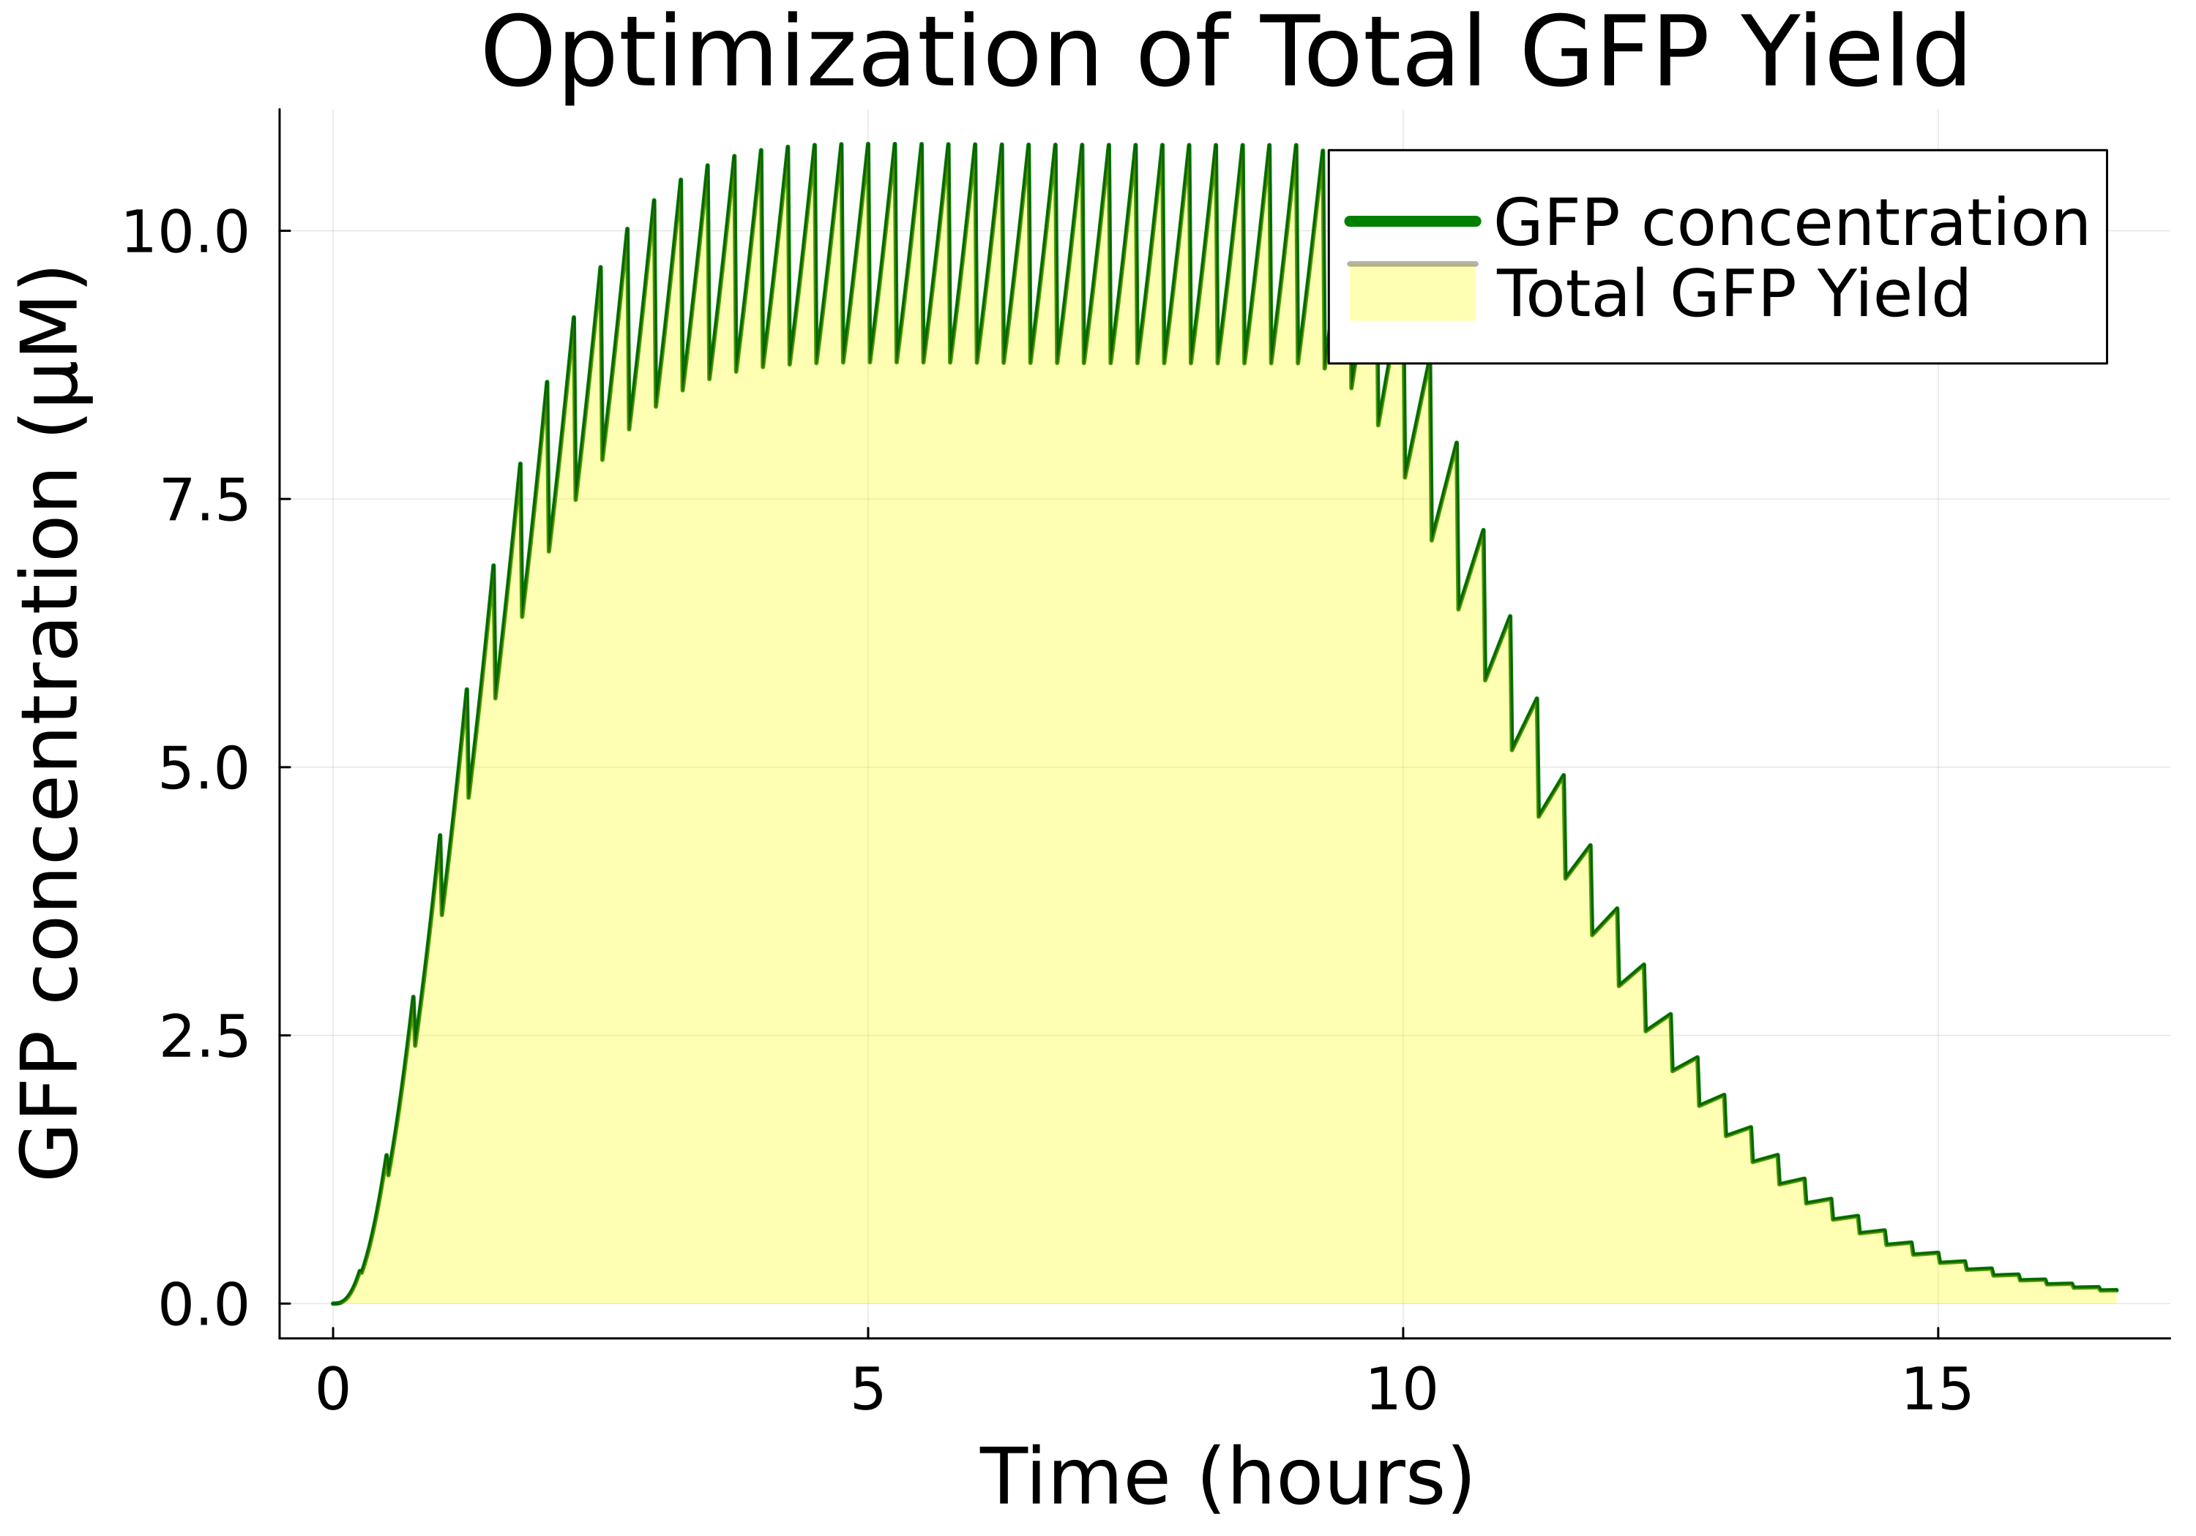
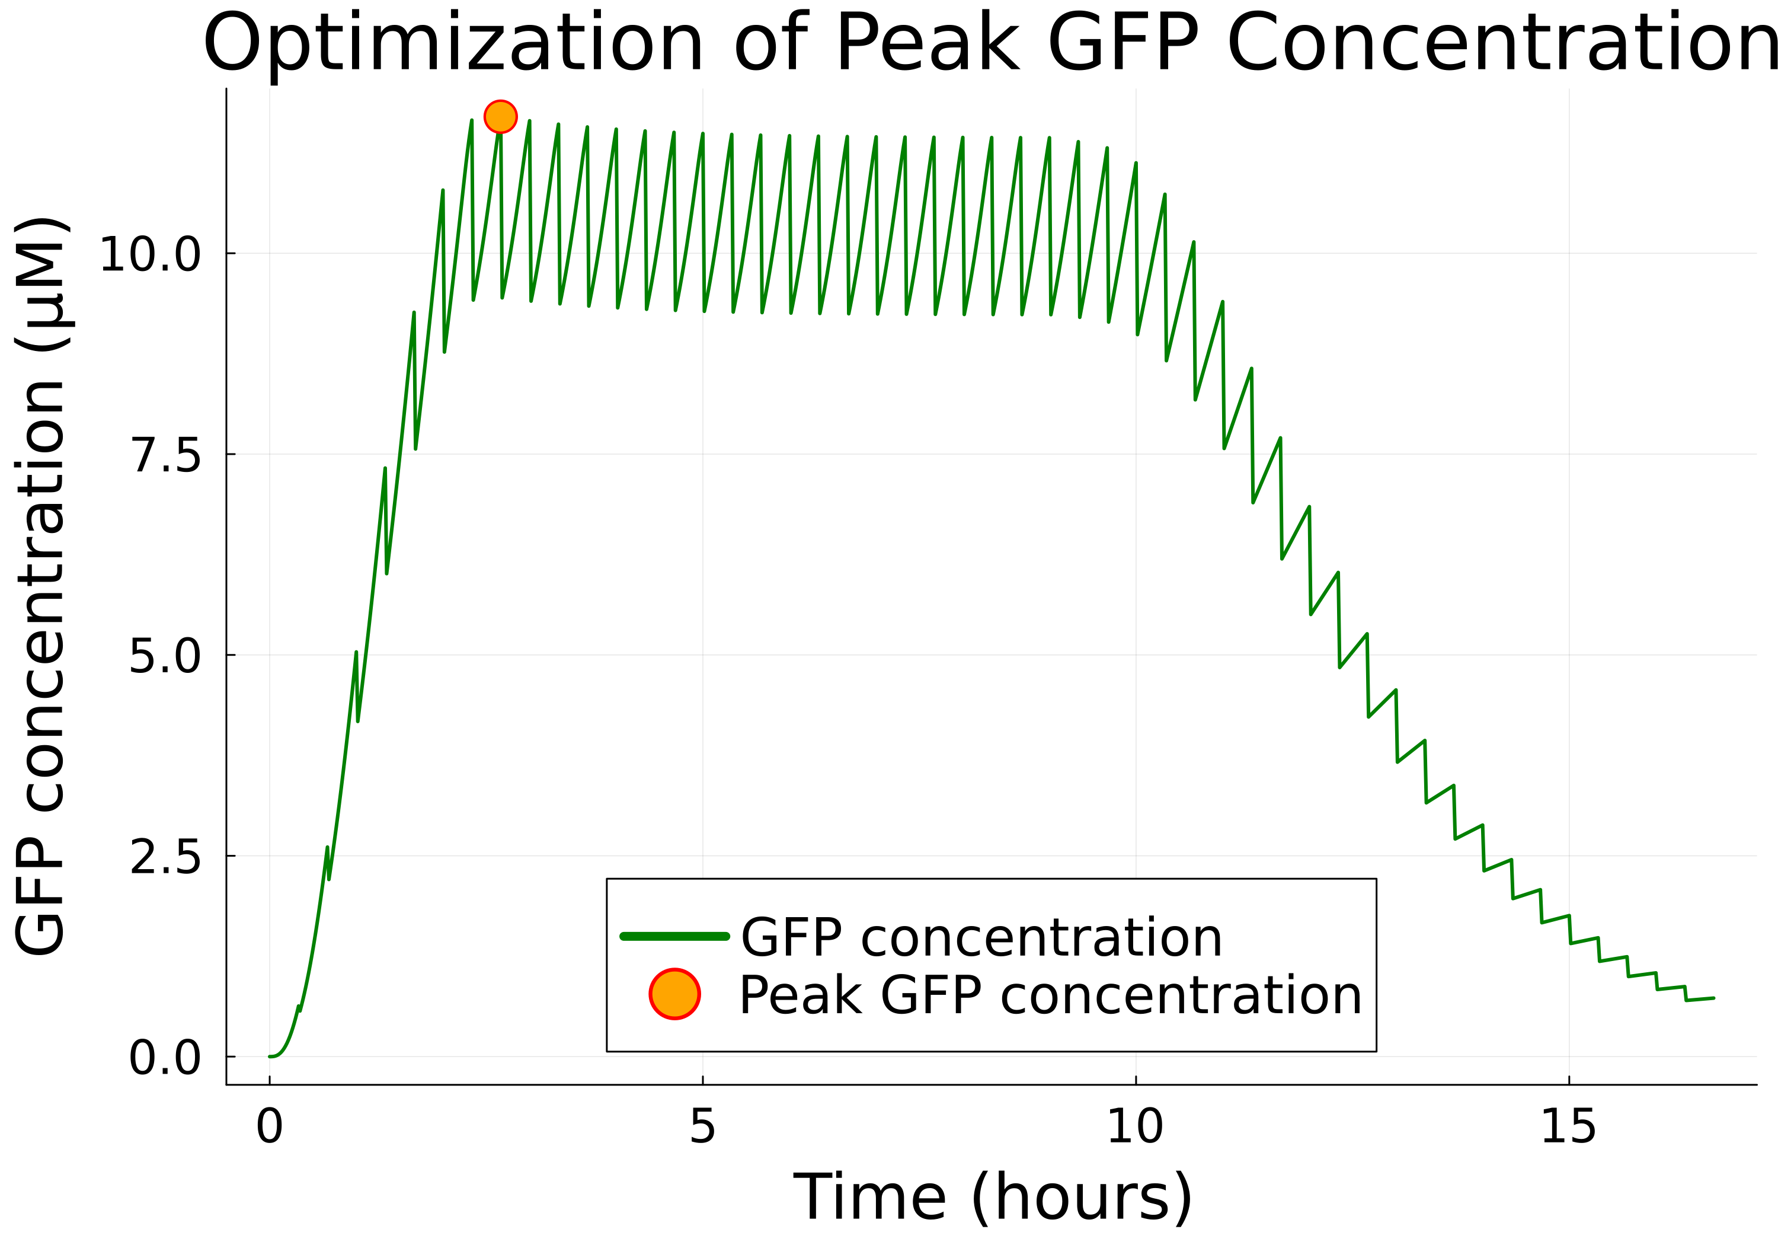
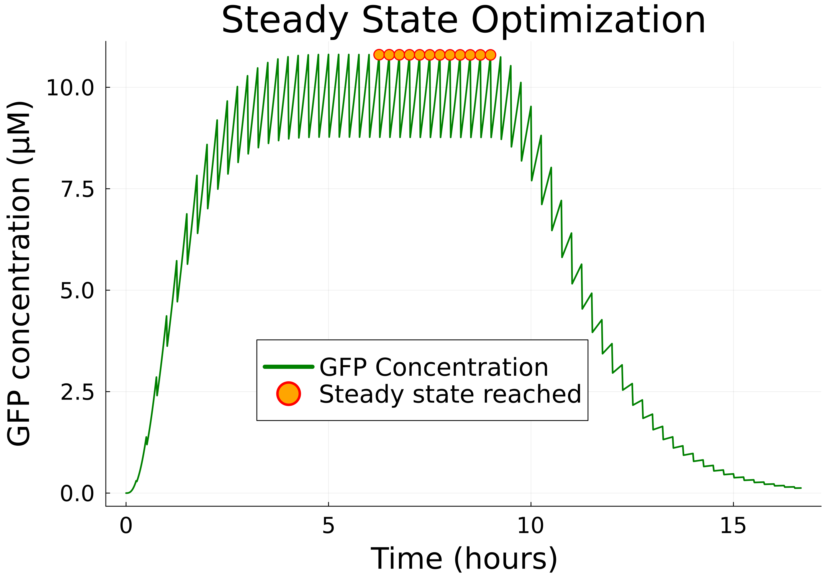
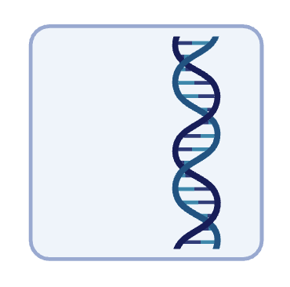
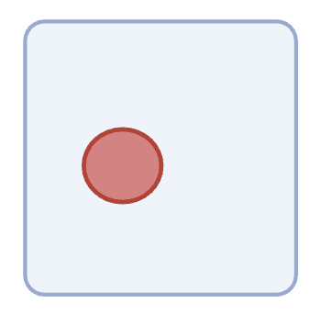
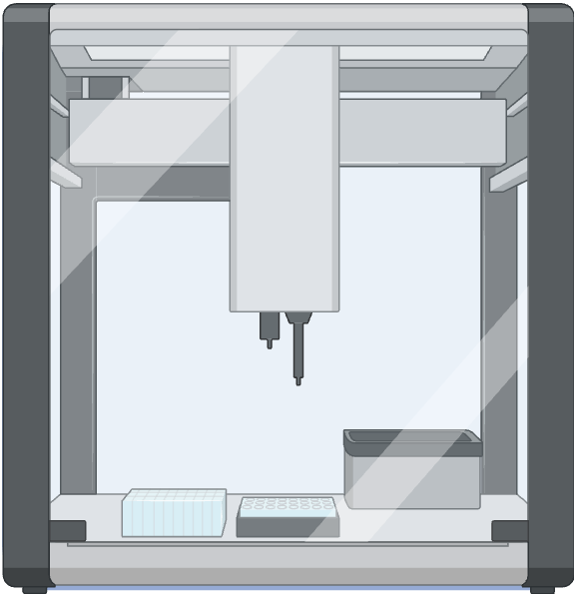
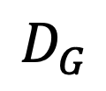
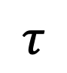
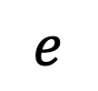
Optimizing cell-free protein synthesis
By changing:
Dilution interval
DNA
$$D_{G}$$
$$e$$
$$τ$$
Energy
Notes:
Total GFP yield – what is the most amount of GFP that we can produce over time
Peak GFP concentration – how can we maximize peak GFP concentration to produce one maximally fluorescent instantaneous GFP signal
Steady state optimization – minimize the time taken to reach steady state, and maximize the GFP concentration at steady state
By changing DNA, Energy and the dilution interval
Variables -> 3-dimensional problem space - at some point in the space, the correct combination of variables achieves the desired optimum
So how do we arrive at this global optimum

Slide 7
Optimization algorithms
Initial guess $x_{k}$
Initial guess 𝑥_𝑘
Calculate solution at $x_{k}$
Calculate solution at 𝑥_𝑘
Move to new iteration $x_{k+1}$ based on these values
Move to new iteration 𝑥_(𝑘+1) based on these values
Continue iterations
Solutions converge on an optimum (aka they stop improving)
Choose a direction and distance
Gradient-based algorithms
Use information about the derivatives of the objective function to move to the next iterations
Examples: gradient descent, Newton’s method, L-BFGS, interior point methods
Evolutionary algorithms
Inspired by Darwinian evolutionary systems
Iteratively evolve a population of candidate solutions over several generations
Use mutations, migrations and crossovers between solutions to converge on optimum values
Notes:
Each optimization algorithm starts at an initial guess (e=30,000µM, D=0.005µM, dilution interval 20 minutes)
Calculate the solution here and then change some of the variables to move through the problem space and improve their next guess
Optimization algorithms differ by method they use to move between points
Gradient based algorithms - derivatives of the objective function
Evolutionary algorithms – iteratively evolve a population of candidate solutions by breeding them together, simulating natural selection

Slide 8
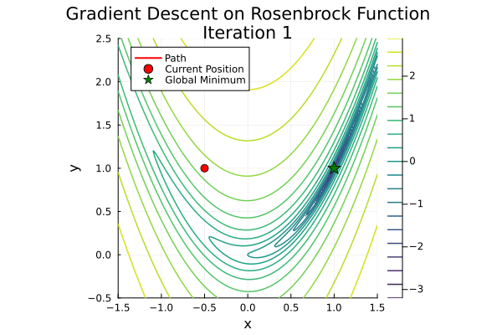

Optimization: comparing algorithms
Constructs a model function at each solution to guide distance and direction to next iterations
Each iteration moves in opposite direction to gradient
Notes:
Gradient descent – moves in opposite direction of the gradient to go to the next iteration
LBFGS – constructs a model function around each iterate – simulate the second derivative – curvature of the function
Speed of solutions

Slide 9
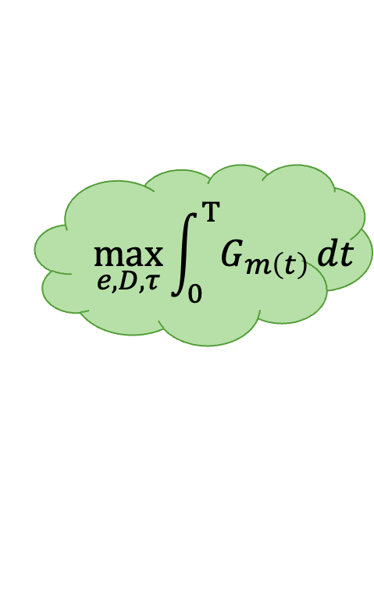
Maximizing total GFP yield
Improve bioreactor configuration
Maximum resource efficiency
High-yield sustained protein synthesis over time
Bulk chemicals, therapeutic proteins etc.
$$\max_{e,D, τ}{\int_{0}^{Τ}{G_{m\left(t\right)}}}dt$$
Notes:
First optimization problem we aimed to apply these algorithms to:
Total GFP yield – changing DNA, energy and dilution interval
Feed the integral of the Gm curve back into the algorithms
Improving bioreactor configuration and maximizing resource efficiency

Slide 10
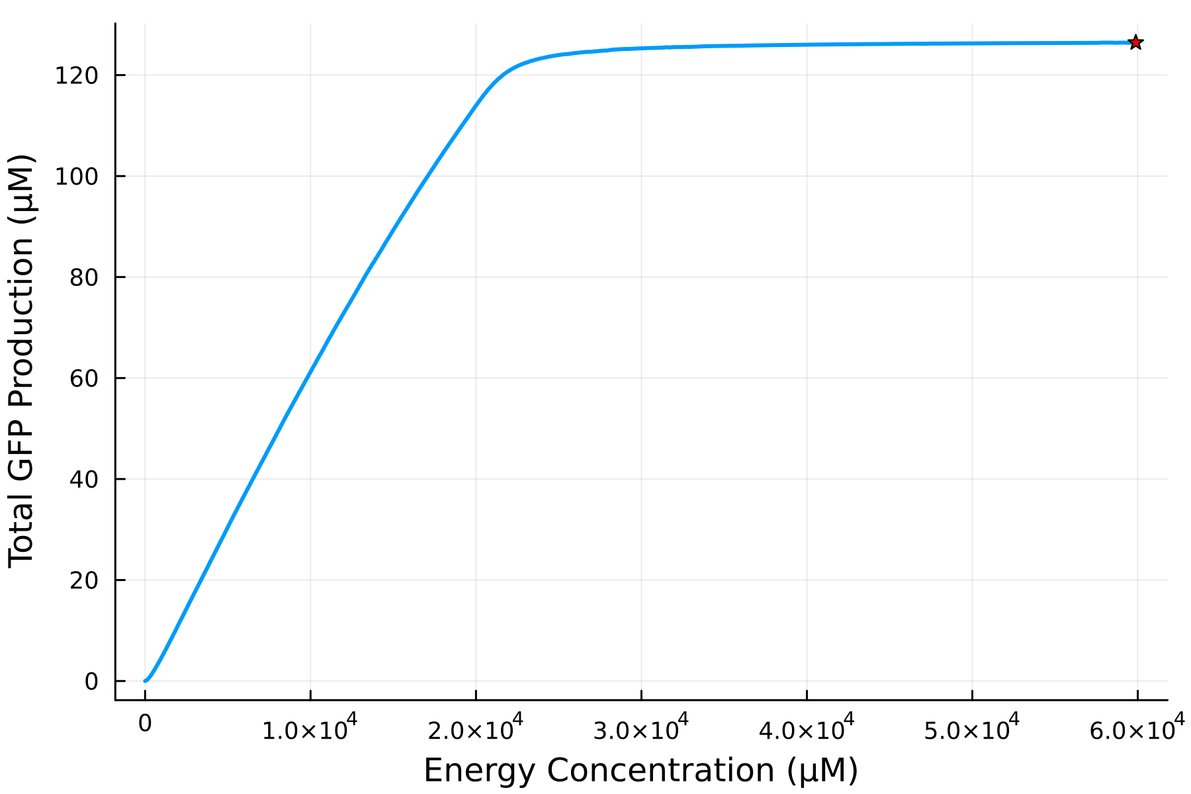
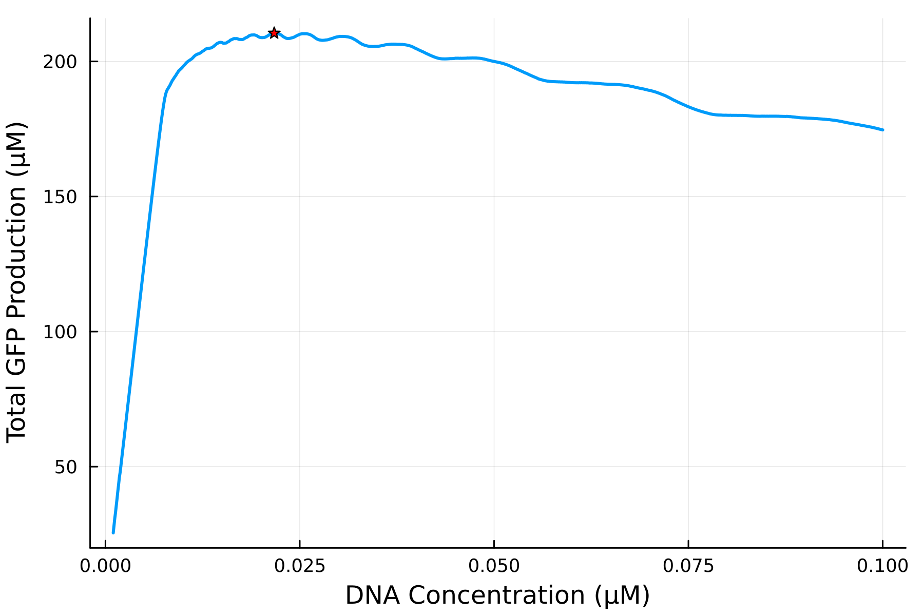
Changing DNA and energy to maximise total yield
Effect of energy concentration on total GFP
Effect of DNA concentration on total GFP
Total GFP concentration (µM)
Total GFP concentration (µM)
Energy Concentration (µM)
DNA Concentration (µM)
Notes:
Maximum energy concentration -> greatest total GFP yield
Higher DNA concentration -> more energy channeled into transcription than translation.
Nelder-Mead algorithm struggled for one dimensional problems
Algorithm can only move along a single straight line in search of improved solutions
All the other algorithms we tried performed well

Slide 11
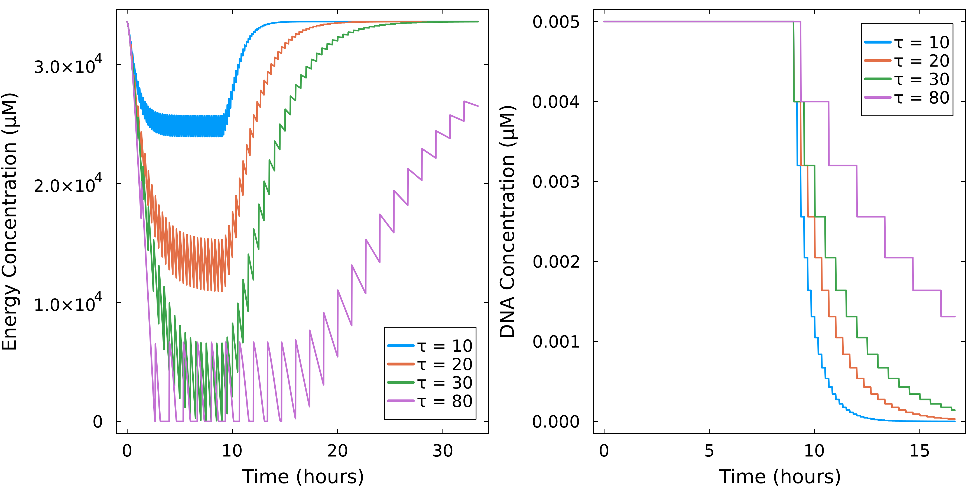
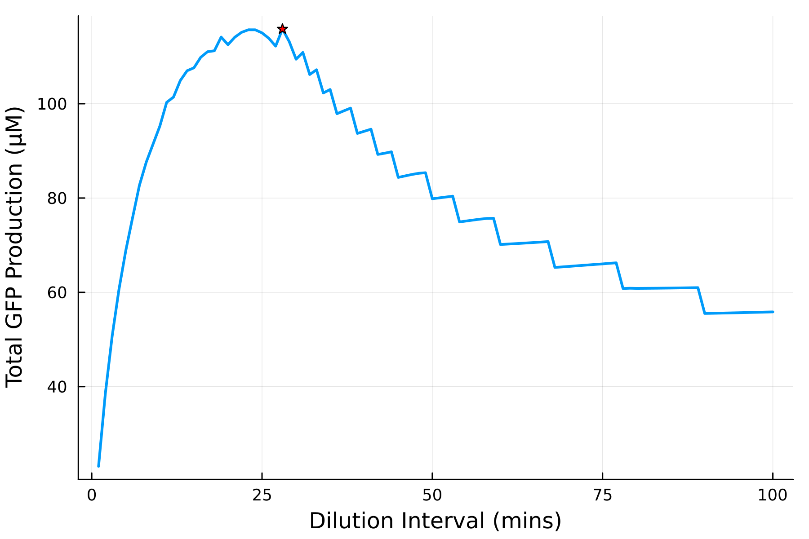
Changing dilution interval to maximize total yield
Energy concentration over time at different dilution intervals
Effect of dilution interval on total GFP
Total GFP Produced (µM)
Energy Concentration (µM)
Dilution interval (minutes)
Time (hours)
Gradient-based algorithms struggled due to the discrete nature of the dilution interval
Notes:
Short dilution intervals -> failed to fully consume energy and mRNA before dilution
Long dilution intervals -> leave DNA in the system for longer after the washout phase -> but periods of complete energy depletion
Gradient-based optimization algorithms -> fail -> discrete nature of the dilution intervals

Slide 12
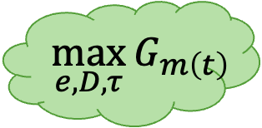
Maximizing the peak GFP concentration
Improving signal-to-noise-ratio for diagnostic tools
Detection of biomarkers and pathogens
Measurable signals for high-throughput screening applications.
$$\max_{e,D, τ}{G_{m\left(t\right)}}$$
Notes:
Maximum peak GFP – change energy, DNA and dilution interval
Feed peak mature Gm value back into the optimization algorithms.
Diagnostic tools -> intense signal to be detected above background noise
High-throughput screening applications – clear outputs that can be easily detected.

Slide 13
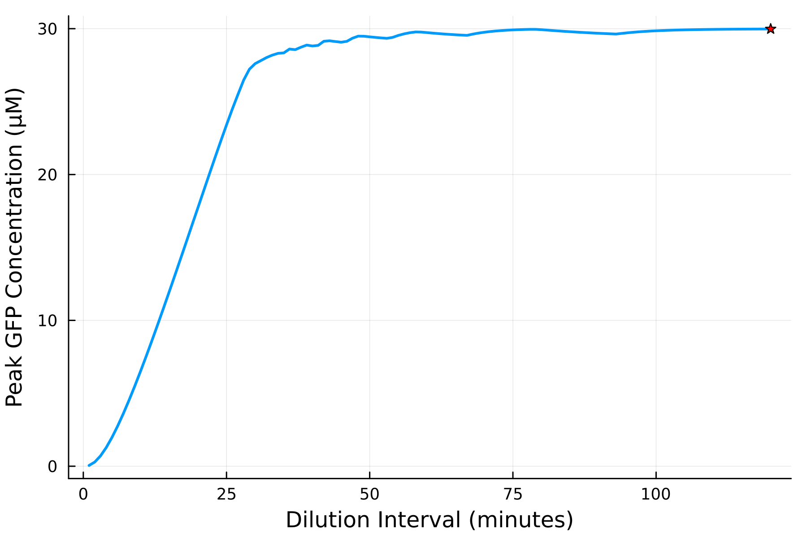
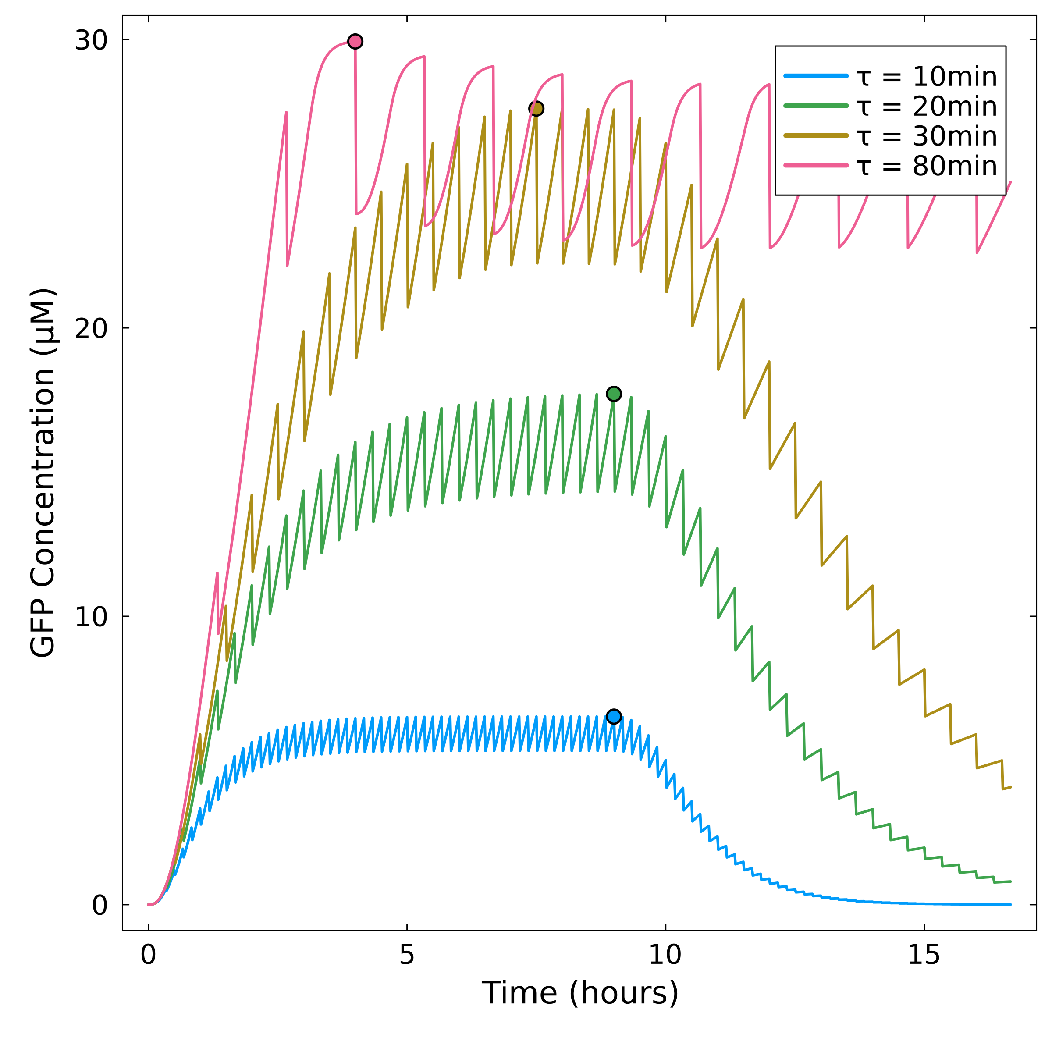
Changing dilution interval to maximize peak GFP conc.
Effect of dilution interval (τ) on the peak GFP concentration
GFP concentration over time at different dilution intervals
Peak GFP Concentration (µM)
GFP Concentration (µM)
Dilution interval (minutes)
Time (hours)
Notes:
High energy concentration -> higher peak GFP concentration.
Optimum DNA -> slightly lower
Longer dilution interval – all energy and RNA can be used in the first few cycles – sharp initial increase before steady-state

Slide 14
Optimizing a cell-free system
Cell-free optimization: steady-state
Minimizing reactor ‘downtime’ and reducing batch length
Importance of speed in diagnostic applications
System robustness
Notes:
Minimize time taken to reach steady state
Maximize the GFP concentration at steady state
Calculate maximum concentration change between each dilution cycle
Concentration change less than 1% -> steady state

Slide 15
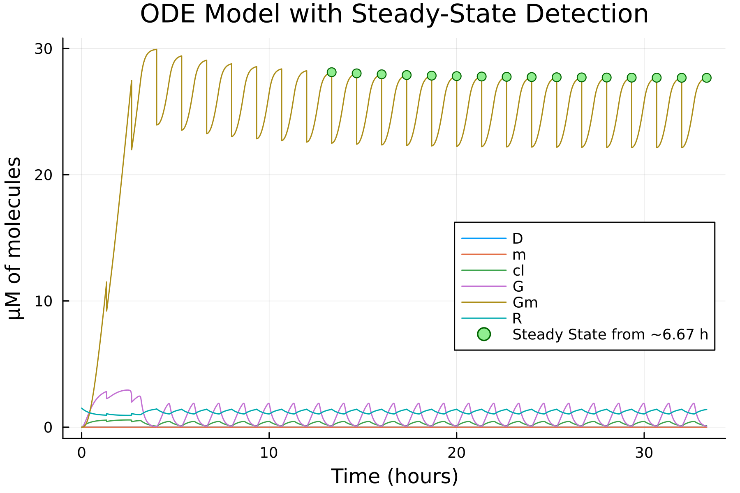
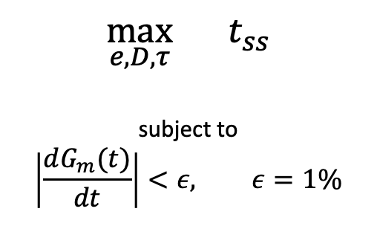
Optimizing a cell-free system
How do we detect when the system is at steady state?
ODE Model With Steady State Detection
$$\max_{e,D, τ}{t_{ss}}$$
subject to
$$\left|\frac{dG_{m}(t)}{dt}\right|<ε, ε=1\%$$
Notes:
Lacked accuracy (flatlines)
SS only detected after a full cycle (or multiple cycles depending on how strict the conditions supplied to the algorithm are) have occurred
Various objective values lead to same time taken to reach steady state.

Slide 16
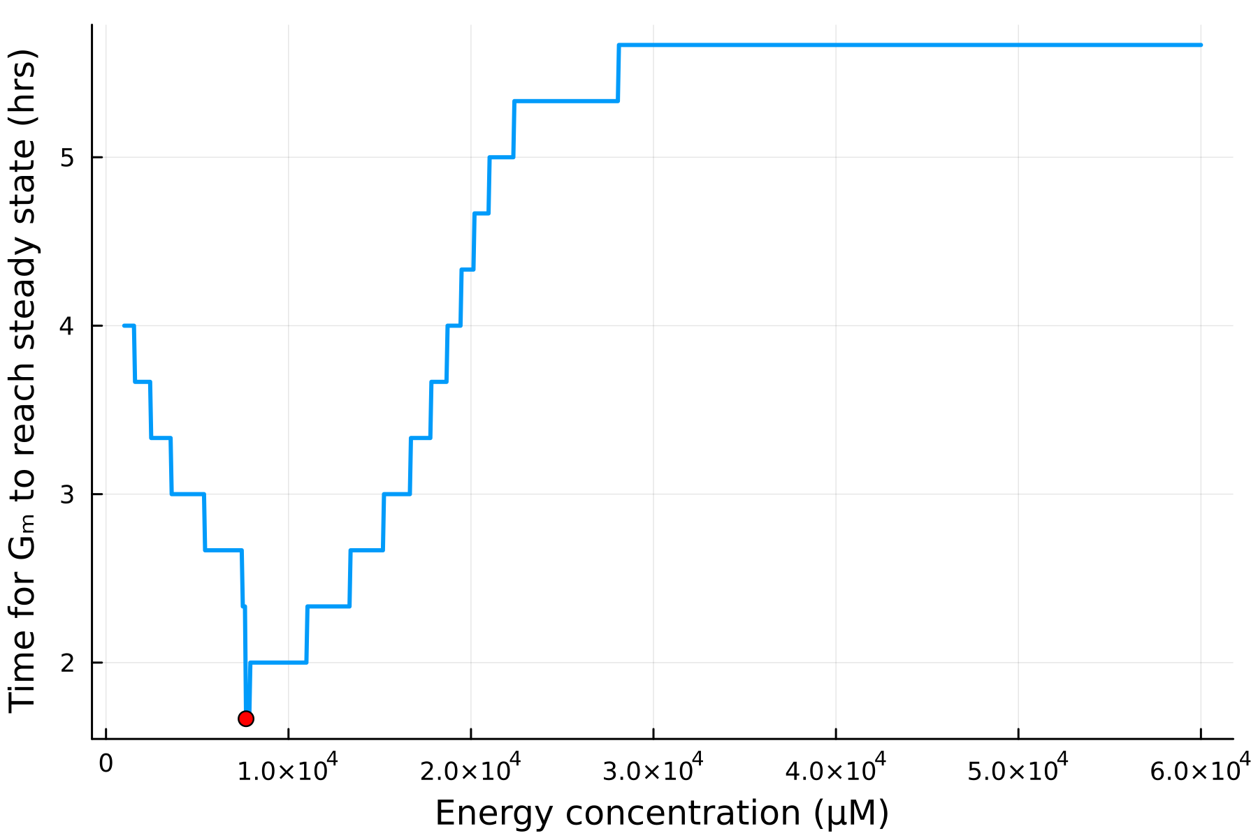
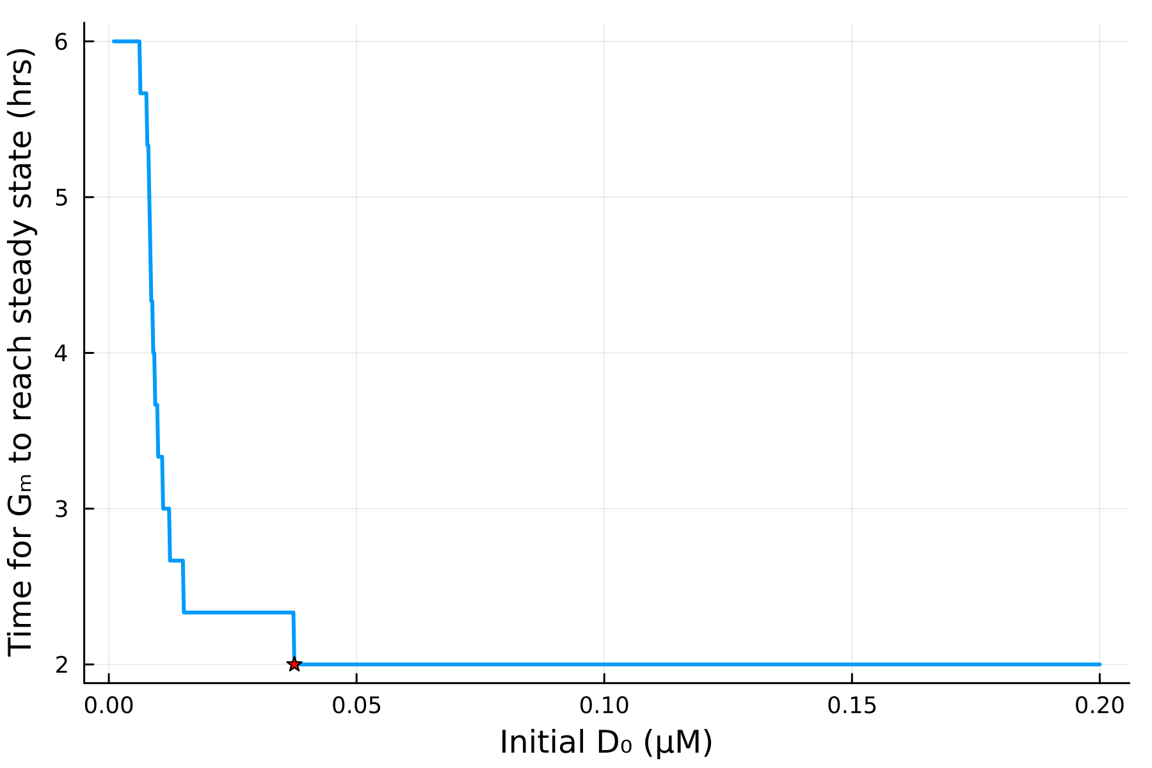
Optimizing a cell-free system
Minimizing time taken to reach steady state by changing energy and DNA
Effect of energy concentration on time taken to reach steady state
Effect of DNA concentration on the time taken for GFP to reach steady state
Time taken for GFP to reach steady state (hrs)
Time taken for GFP to reach steady state (hrs)
Energy concentration (µM)
DNA Concentration (µM)
Notes:
Lacked accuracy (flatlines)
SS only detected after a full cycle (or multiple cycles depending on how strict the conditions supplied to the algorithm are) have occurred
Various objective values lead to same time taken to reach steady state.

Slide 17
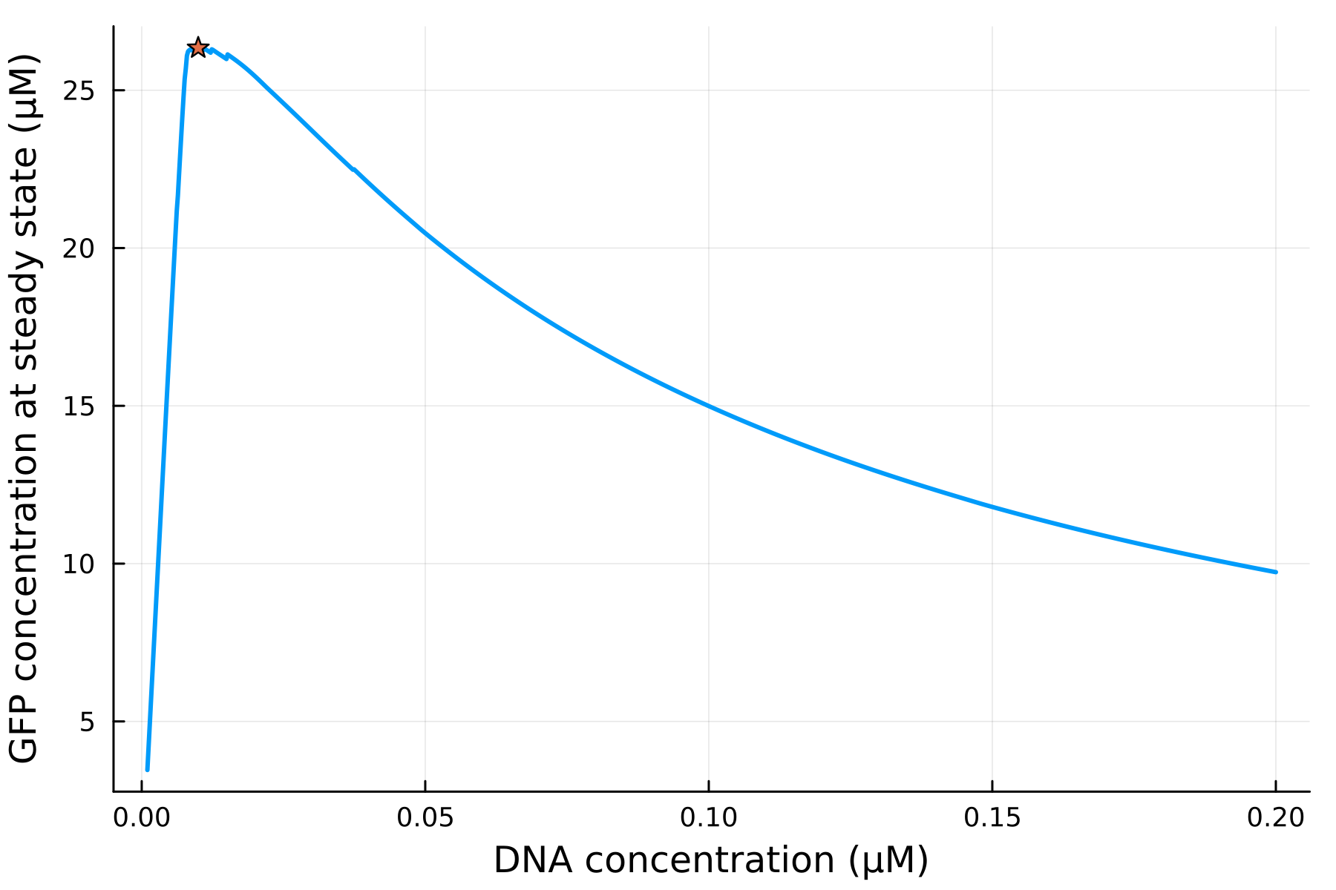
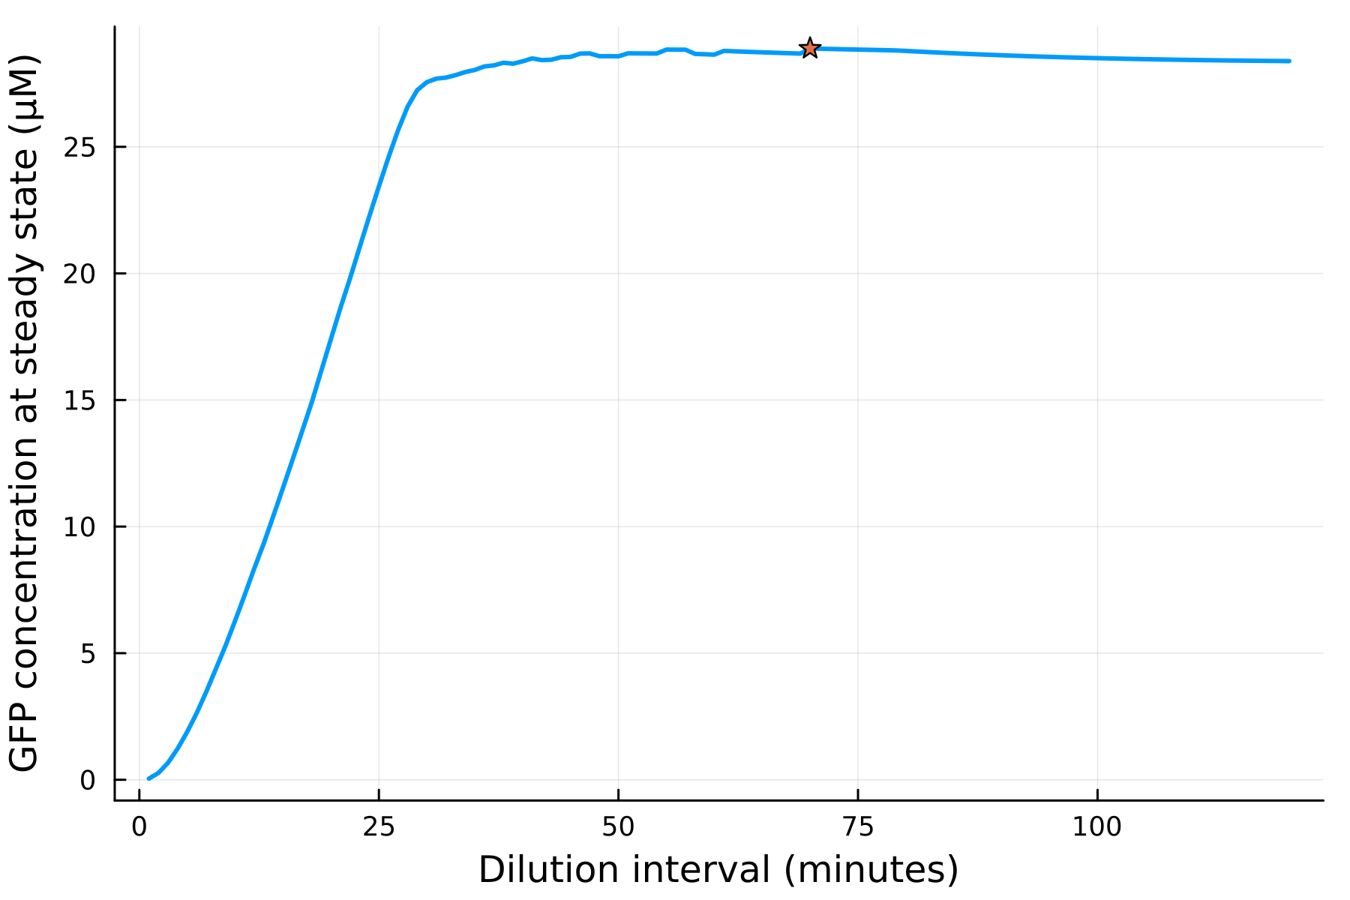
Optimizing a cell-free system
Maximizing the GFP concentration at steady state
Effect of DNA concentration on the GFP concentration at steady state
Effect of dilution interval on the GFP concentration at steady state
GFP concentration at steady state (µM)
GFP concentration at steady state (µM)
DNA concentration (µM)
Dilution interval (mins)
Notes:
Lacked accuracy (flatlines)
SS only detected after a full cycle (or multiple cycles depending on how strict the conditions supplied to the algorithm are) have occurred
Various objective values lead to same time taken to reach steady state.

Slide 18
Optimizing a cell-free system
Optimization results
Total GFP Produced
Peak GFP Concentration
Time to Steady State
GFP at Steady State
Original
chemostat
125µM
17.7µM
5.33 hrs
17.5µM
Optimized results
442µM
54.8µM
0.335 hrs
46.4µM
354% increase
310% increase
1524% decrease
265% increase

Slide 19

Cell-ebrating Efficiency: Optimization Algorithms Meet Biological Systems
Thank you for listening!
Malachy McEvoy | s2277725@ed.ac.uk
Supervision by Dr. Andrea Weisse and Christoph Wagner
Notes:
Moving forward:
Test these findings in a real system
Observe changing volumes – not just fixed at 20µM
Continue to improve our understanding of in vitro TX-TL

